Slide 1
MI-Volunteer Registry Overview
R2N HCC Advisory / Planning Board
March 8, 2023
Presented by Rick Drummer

Slide 2
The Emergency System for Advance Registration of Volunteer Health Professionals
The Emergency System for Advance Registration of Volunteer Health Professionals (ESAR-VHP) is a federal program created to support states and territories in establishing standardized volunteer registration programs for disasters and public health and medical emergencies.
The program, administered on the state level, verifies health professionals' identification and credentials so that they can respond more quickly when disaster strikes. By registering through ESAR-VHP, volunteers' identities, licenses, credentials, accreditations, and hospital privileges are all verified in advance, saving valuable time in emergency situations.
The MVR is the Michigan answer to ESAR-VHP

Slide 3
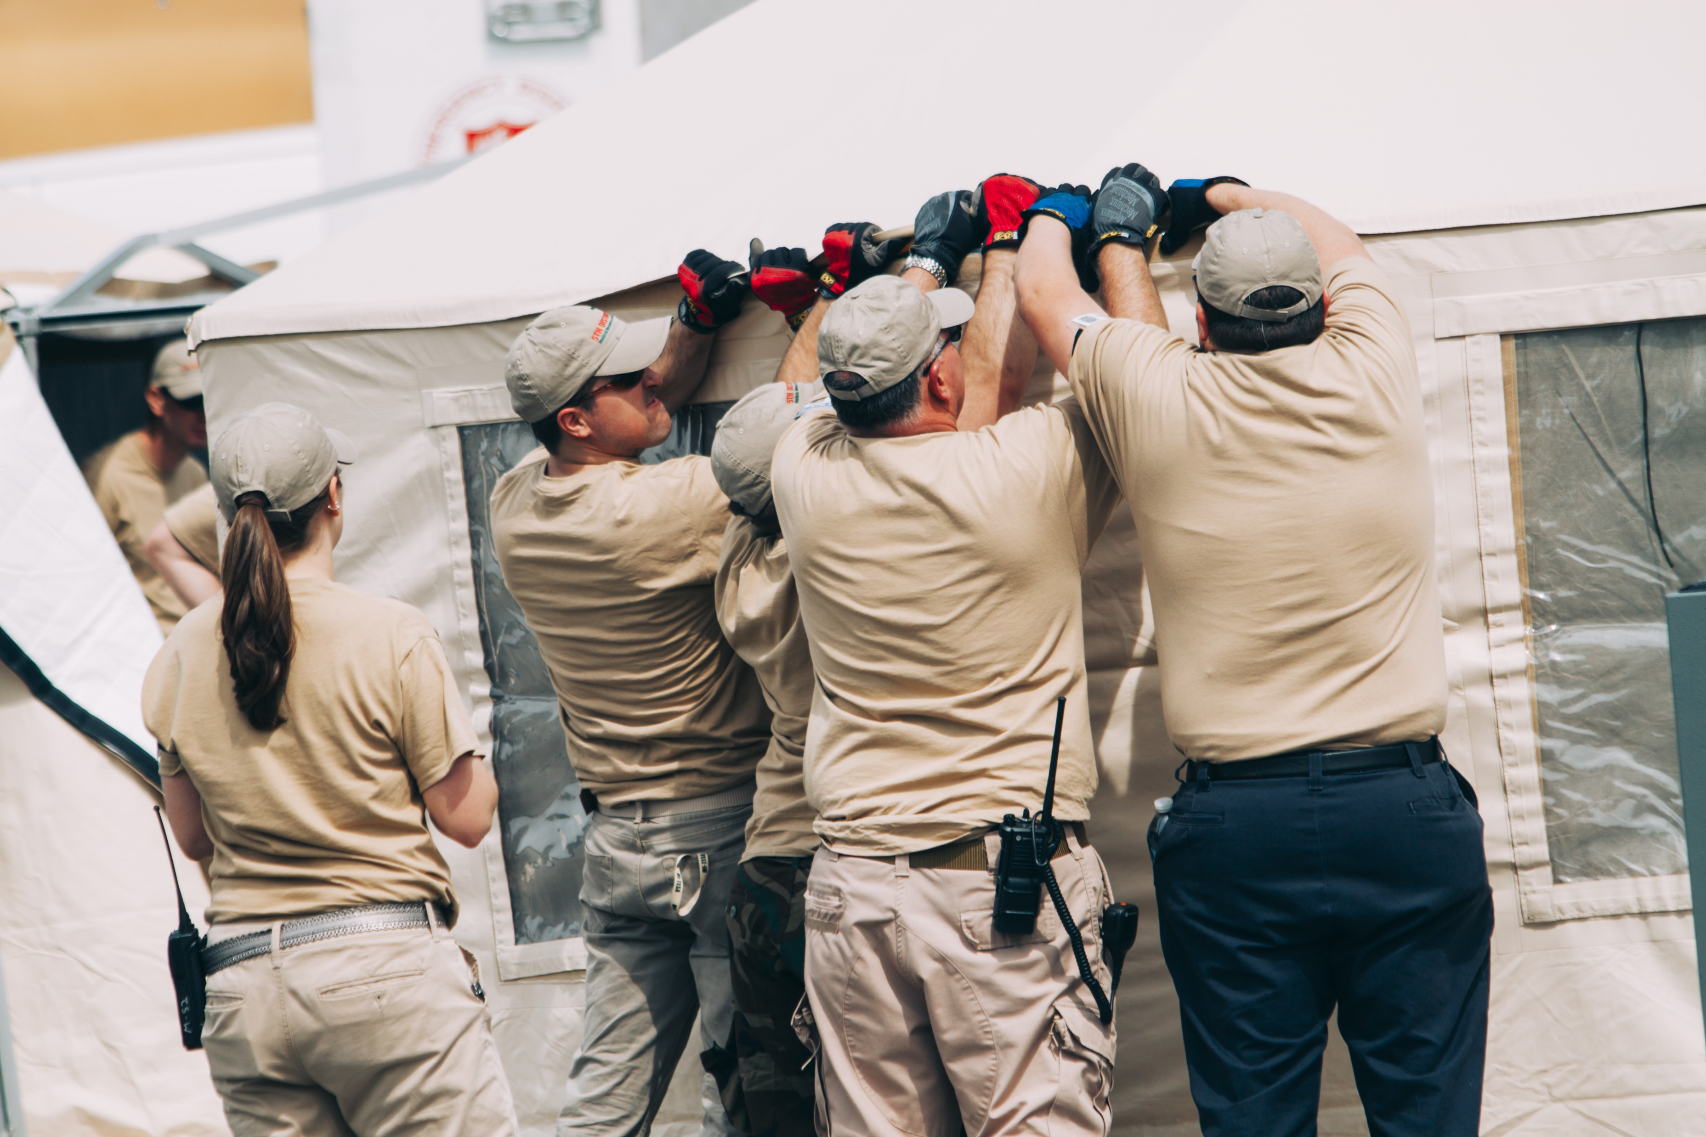
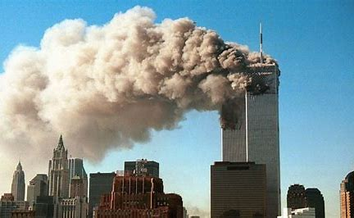
Notes:
So, what is the MVR? Well, to understand what it is, we first need to explain why it exists…
Following the attacks on 9/11, former President George W. Bush created several Essential Support Functions to be managed by public health entities in each state of the country. This office in the state of Michigan is called the Bureau of Emergency Preparedness, EMS and Systems of Care (BEPESOC). **The bureau recently changed its name from BETP to BEPESOC and does not currently have an updated logo.**
The Division of Preparedness and Response (DEPR) within BEPESOC is comprised of the Public Health Emergency Preparedness (PHEP) Program and the Hospital Preparedness Program (HPP). PHEP is federally funded by the Centers for Disease Control (CDC) and HPP is federally funded by the Assistant Secretary for Preparedness and Response (ASPR).

Slide 4
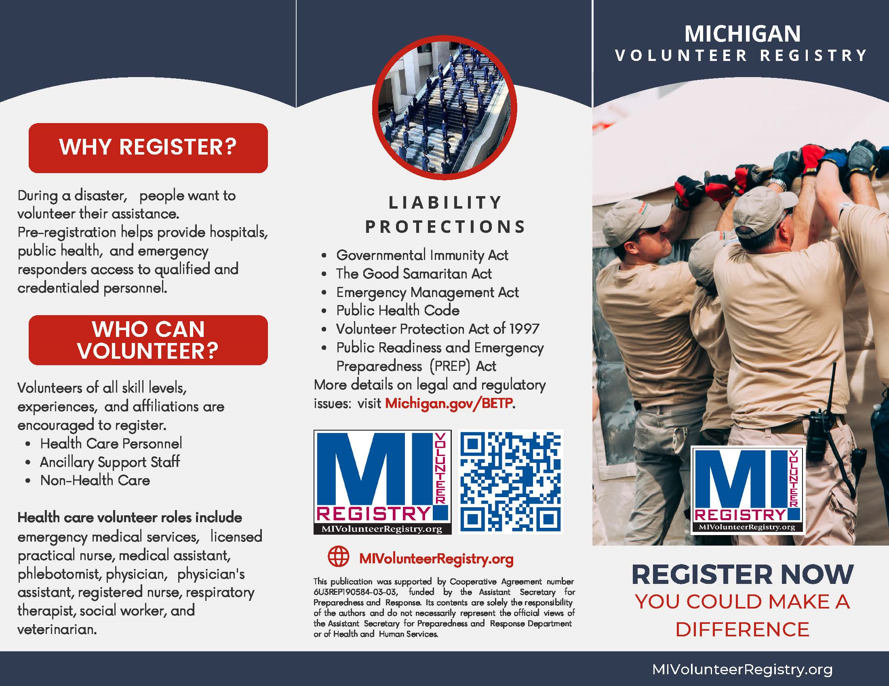
Notes:
The MVR provides several benefits for the registration and mobilization of volunteers during a public health or medical emergency:
VERIFICATION: most importantly, the MVR provides a central, web-based repository for volunteer contact and credential information and has a built-in verification mechanism for most medical credentials and hospital privileges or employment. This is a unique feature of the MVR-there is no other volunteer org/program with the same capabilities!
SAFETY: a background check through ICHAT and the National Sex Offenders Registry is also performed on all applicants before they are accepted as a volunteer and prior to every deployment.
LIABILITY COVERAGE: registration can afford workers’ compensation to volunteers and protect them from civil liability. These benefits are provided for approved MVR volunteers only.
SPECIALIZATION: in an emergency, MVR administrators can quickly and easily query volunteers for particular skill sets, trainings, occupations, and location as well as quickly contact them regarding deployment.

Slide 5
Notes:
The MVR provides several benefits for the registration and mobilization of volunteers during a public health or medical emergency:
VERIFICATION: most importantly, the MVR provides a central, web-based repository for volunteer contact and credential information and has a built-in verification mechanism for most medical credentials and hospital privileges or employment. This is a unique feature of the MVR-there is no other volunteer org/program with the same capabilities!
SAFETY: a background check through ICHAT and the National Sex Offenders Registry is also performed on all applicants before they are accepted as a volunteer and prior to every deployment.
LIABILITY COVERAGE: registration can afford workers’ compensation to volunteers and protect them from civil liability. These benefits are provided for approved MVR volunteers only.
SPECIALIZATION: in an emergency, MVR administrators can quickly and easily query volunteers for particular skill sets, trainings, occupations, and location as well as quickly contact them regarding deployment.

Slide 6
Organizations in the MVR
Notes:
The MVR has an internal structure of organizations to which volunteers may apply:
There is County Affiliation - all 83 counties plus Wayne County (or the City of Detroit)
Then there is Statewide Team Affiliation, which is comprised of several teams:
-Community Emergency Response Team, (CERT)
-Division of Victim Services Mass Violence Response
-Fire Corps
-Medical Reserve Corps (MRC)
-MI Mortuary Response Team (MI-MORT)
-MI Transportable Emergency Surge Assistance (MI-TESA) *MI-MORT & MI-TESA are state assets, which means they are funded by BETP*
-National Ski Patrol
-Neighborhood Watch
-Tribal Response Teams -Volunteers in Police Service (VIPS)

Slide 7
R2N MVR
R2N staff are administrators in MVR system
R2N has badging systems for MVR credentialling
MVR used for MI-MORT, MI-TESA, Macomb County MRC, and others
Used for support during meningitis incident
Used for COVID testing and monoclonal therapy volunteers
Used for water crisis distribution centers
Can be used for events for first aid or water stations
2,563 volunteers in system if you query Region 2 North

