Slide 1
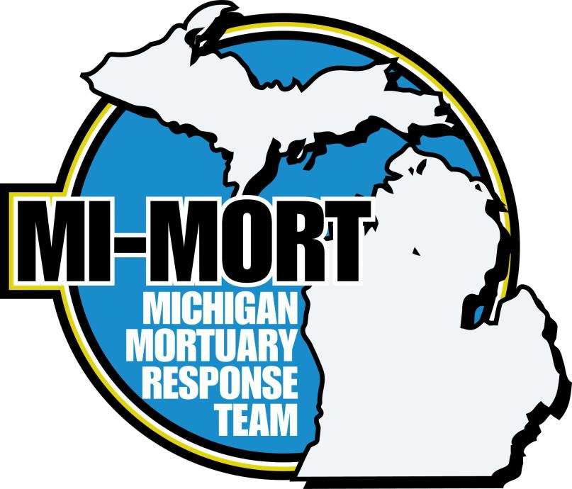
Understanding the MI-MORT Puzzle
Command
Staff
Morgue
Operations
MIVOL
Registry
ME
Request
DART
And
Remains
Mgt.
Morgue
Information
Center
DPMU
Victim
Information
Center
Remains Identified at End of Process by Medical Examiner

Slide 2
Understanding the MI-MORT Puzzle
Overview
Established in 2007
Requested by local Medical Examiner (do not self deploy)
Specialized team of volunteers to support mass fatality response needs
Collaborative effort between:
Michigan Department of Health and Human Services Bureau of EMS, Trauma and Preparedness
Michigan Funeral Directors Association
Michigan Dental Association Dental Identification Team
Disaster Assistance Recovery Team
Michigan State University Forensic Sciences

Slide 3
Understanding the MI-MORT Puzzle
Mission
The MI-MORT mission is to provide dignified and respectful fatality management services during disaster events. MI-MORT will assist and support local Medical Examiners, local and state law enforcement, local emergency response organizations and the Michigan Department of Health and Human Services with identification of the dead, preservation of evidences, and return of human remains to families.

Slide 4
Understanding the MI-MORT Puzzle
Scalable to Support M.E. Needs for Mass Fatality Response
State of Michigan asset
Mass Fatality = Number of dead exceeds local or regional resources
Medical Examiner makes request through Emergency Management
Provides technical assistance and personnel as requested and available to:
Recover remains
Identify and process deceased victims in a dignified manner
Gather information from surviving family members
Provide documentation

Slide 5
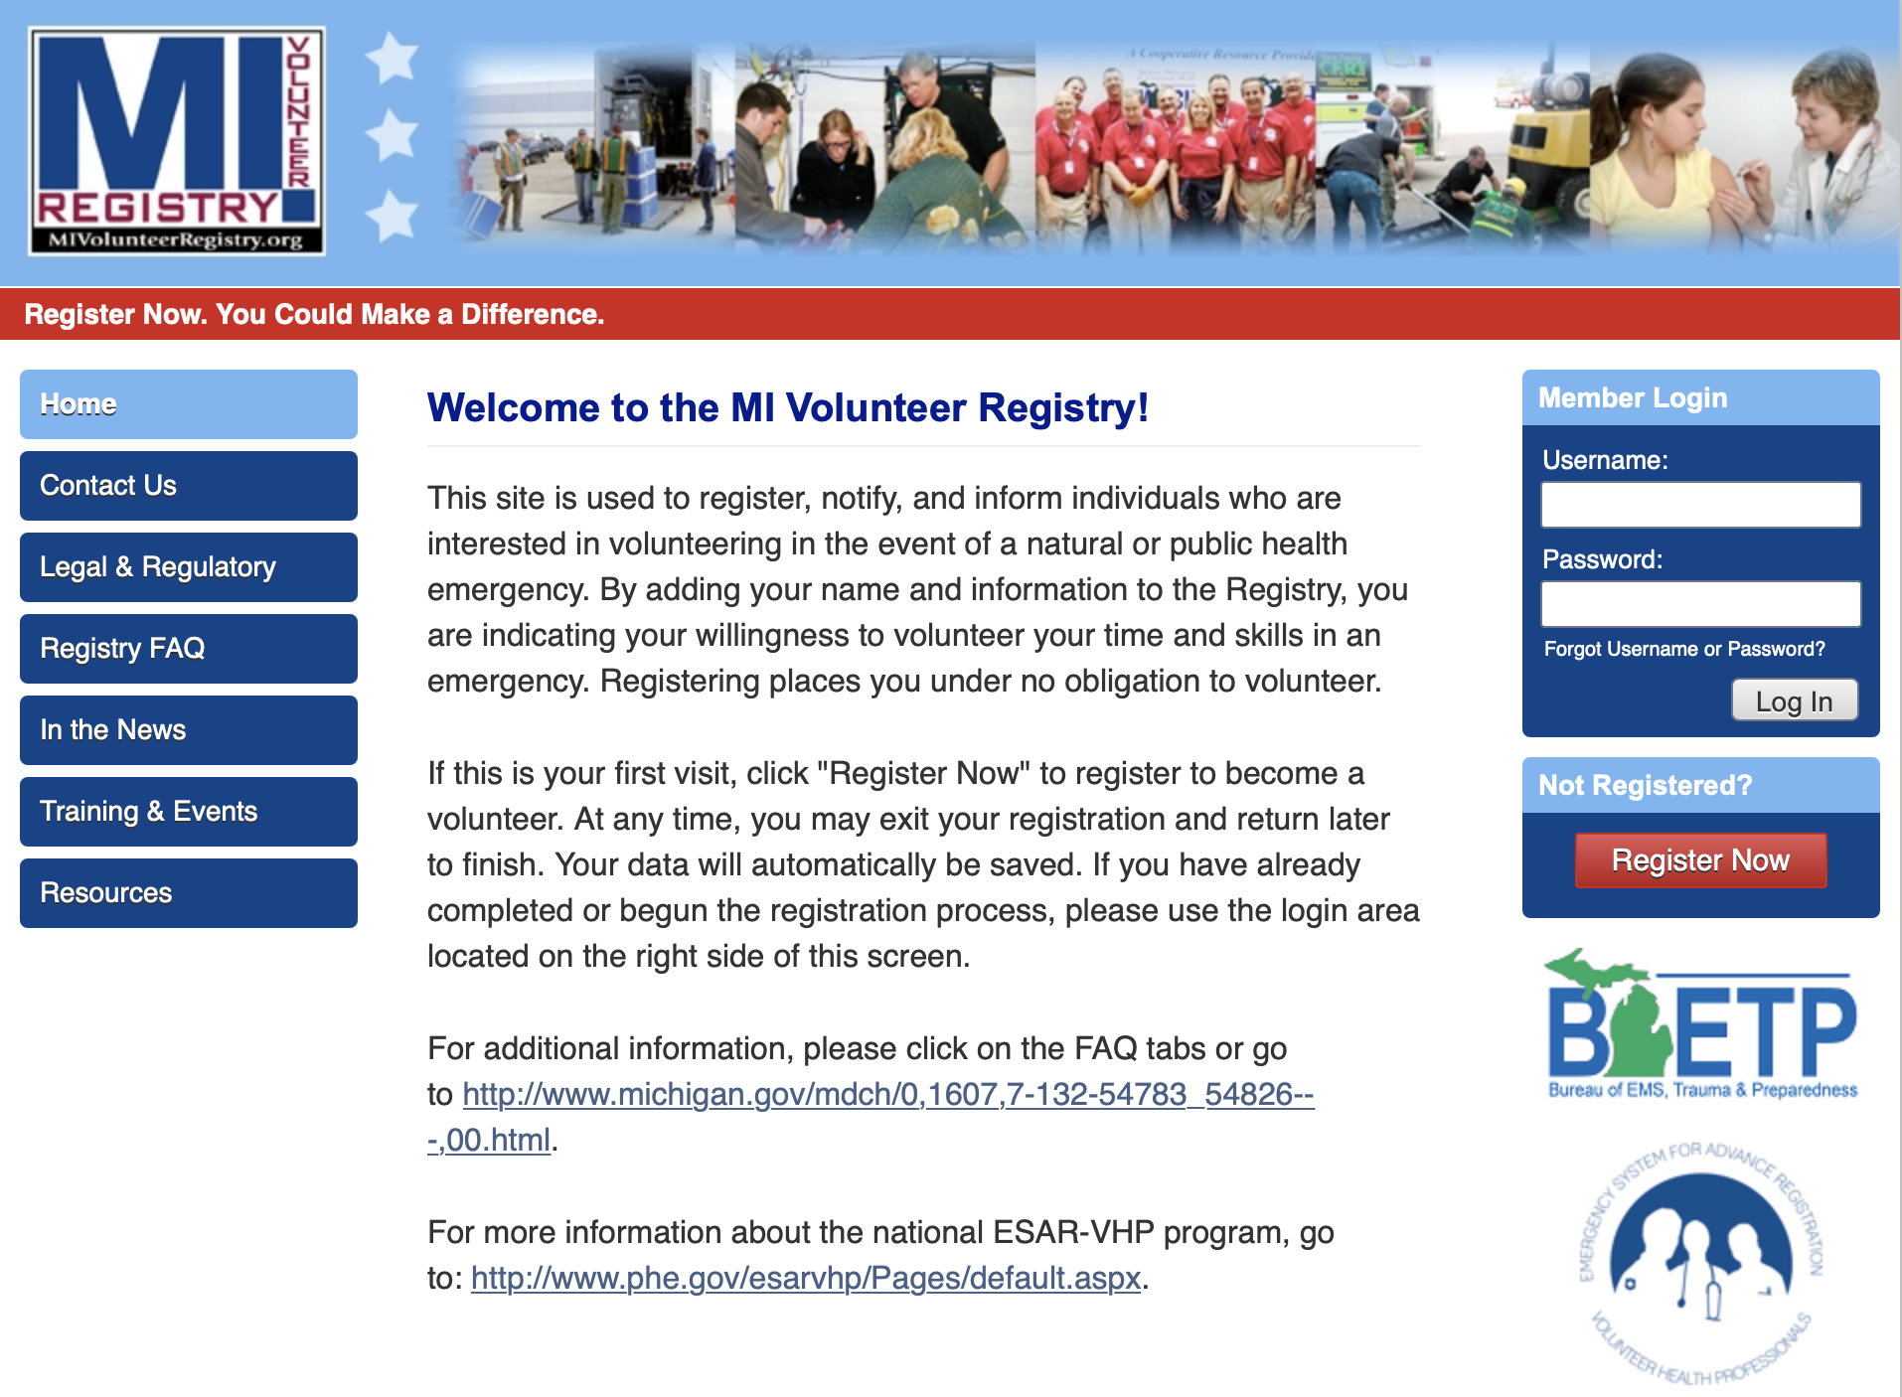
Understanding the MI-MORT Puzzle
Members of MI-MORT Register in the MI-Volunteer Registry
Background checks
Notification protocols
Legal protections
MIVOL
Registry

Slide 6
Understanding the MI-MORT Puzzle
Medical Examiners Act 181 of 1953
Medical Examiners are required by law to conduct investigations into the cause of death in cases of persons who come to their death:
Suddenly
Unexpectedly
Accidentally
Violently
Or as a result of any suspicious circumstances
Duty does not change when victims are multiple
ME for the county in which the deaths occur retains jurisdiction over the bodies
ME
Request

Slide 7
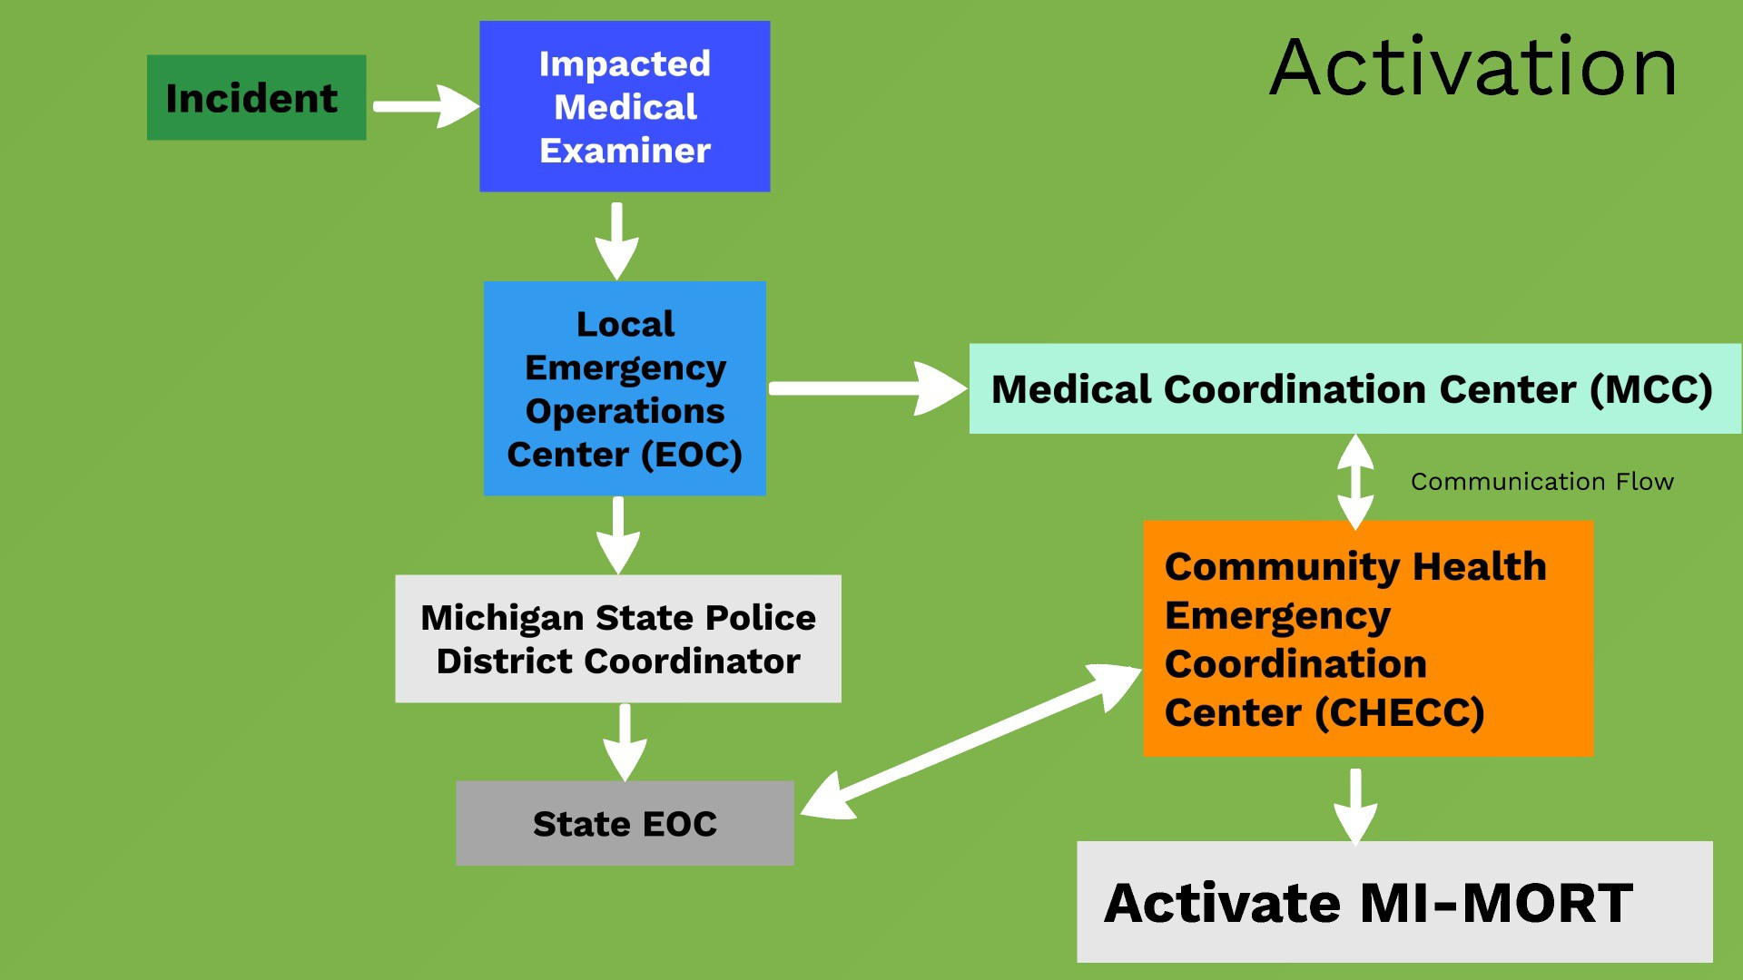

Slide 8
Understanding the MI-MORT Puzzle
Incident Command Staff
MI-MORT uses the Incident Command Structure (ISC) scaled to Medical Examiner request and needs
MI-MORT Commander
Operations Section
Planning Section
Logistics Section
Administration and Finance Section
Command
Staff

Slide 9
Understanding the MI-MORT Puzzle
Command Staff
Meets monthly to work on plans, training, and exercises
Manages MI-MORT equipment
Coordinates with State of Michigan
Works with MI-Volunteer Registry Experts
Command
Staff

Slide 10
Understanding the MI-MORT Puzzle
Command Staff
Components of Command Staff Include:
Commander
Administration
MI Bureau of EMS, Trauma, and Preparedness Support
Logistics, Safety, and Security (Disaster Portable Morgue Unite)
Volunteer Management
Search and Recovery (Disaster Assistance Recovery Team)
Victim Transport
Morgue Operations (various sections)
Victim Information Center
Morgue Information Center
Command
Staff

Slide 12
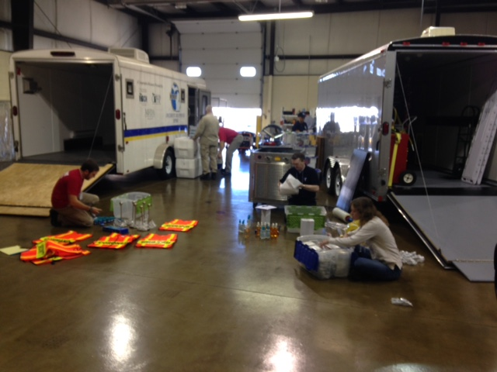
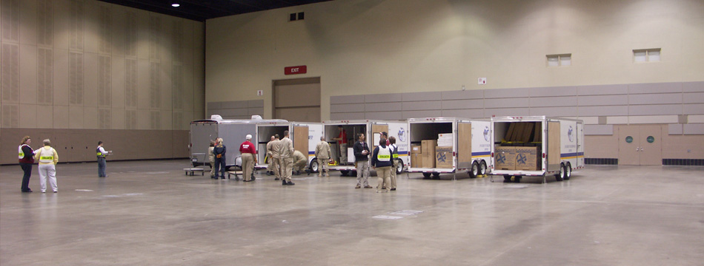
Understanding the MI-MORT Puzzle
Disaster Portable Morgue Unit
Maintained in warehouse
Contains equipment and supplies
Segregated into kits by section
Designed to be erected as needed (scalable)
DPMU

Slide 13
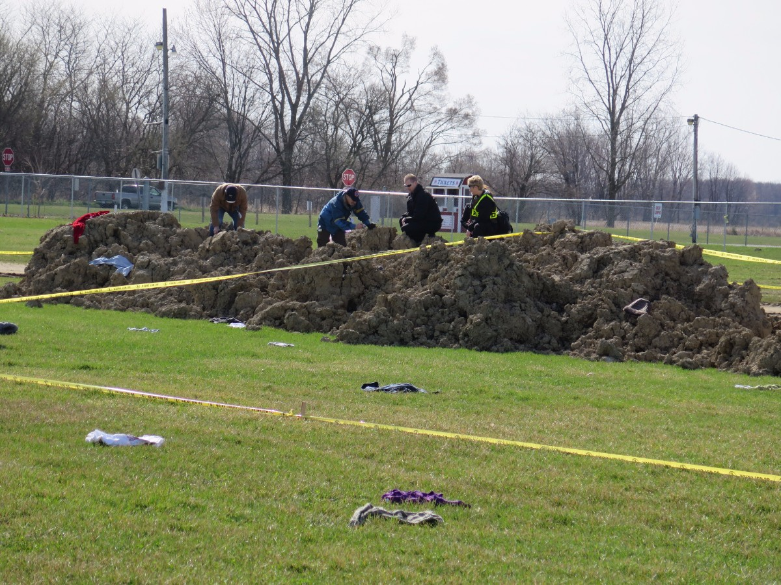
Understanding the MI-MORT Puzzle
Disaster Assistance Recovery Team
Supports local Medical Examiners and Primary Investigators
Provides scene documentation
Provides recovery / collection of human remains and personal effects at mass fatality scene
Arranges transport to Morgue Operations
DART

Slide 14
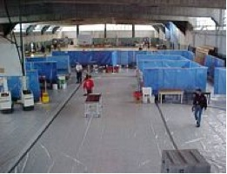
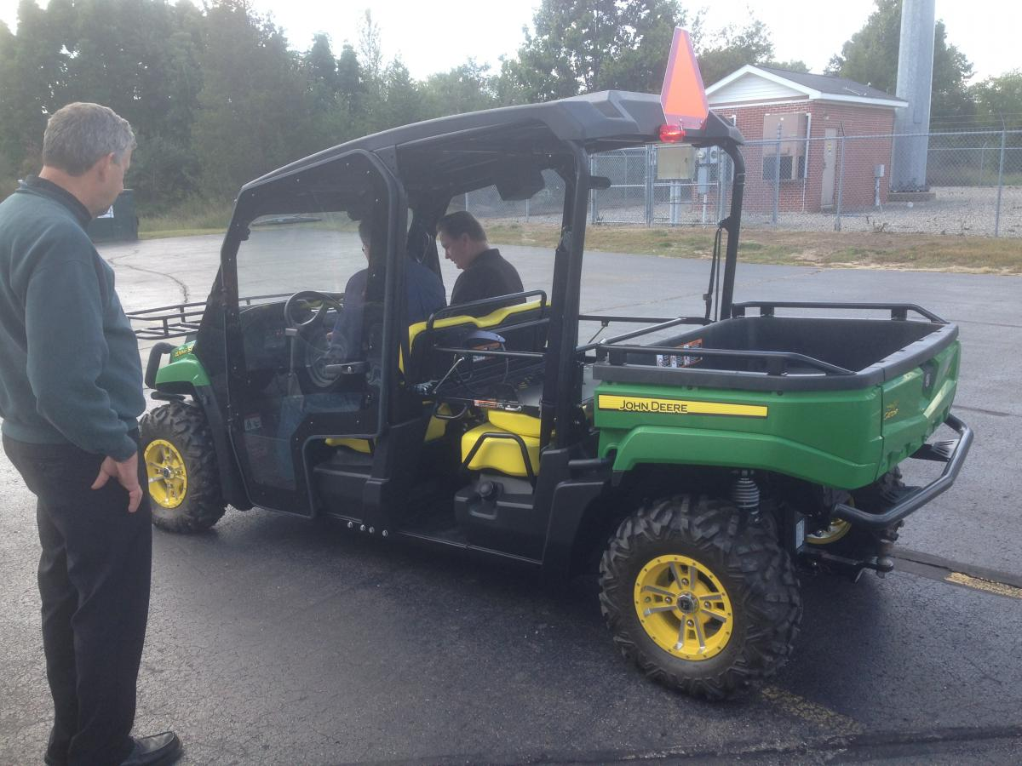
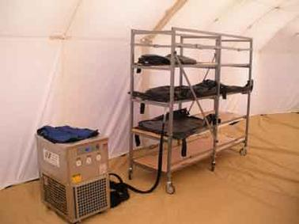
Understanding the MI-MORT Puzzle
Remains Management
Takes custody from DART and transports to Morgue Operations
Tracks remains in morgue and stores in Mobile Emergency Remains Cooling System (MERC)
Remains
Mgt.

Slide 15
Understanding the MI-MORT Puzzle
Morgue
Operations

Slide 16
Understanding the MI-MORT Puzzle
Morgue
Operations

Slide 17
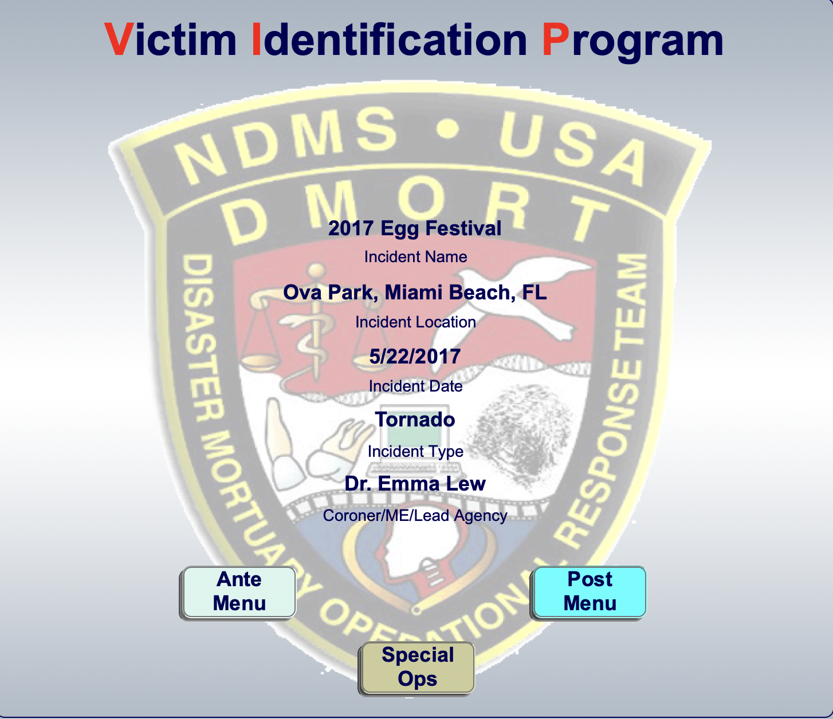
Understanding the MI-MORT Puzzle
Victim Information Center
(located away from morgue and site – Might be at Family Assistance Center)
Step 1:
Receive notification from next of kin, family members, and friends of possible victims
Step 2:
Interviews to collect ante-mortem (before possible death) information, documented in Victim Identification Program (VIP) paperwork
Step 3:
Enter data from interview into Victim Information Profile (VIP) Database System
Step 4:
Collect DNA familial sample, photos, records, etc. Update VIP
Victim
Information
Center

Slide 18
Understanding the MI-MORT Puzzle
Morgue Information Center
Located close to Morgue Operations
Assigns remains number for tracking
Creates paperwork files
Data entry into Victim Information Program (VIP) from post-mortem data
Medical records follow-up
Receipt and distribution of ante-mortem records
Fingerprint ante and post-mortem comparison
Dental ante and post-mortem comparison
Records management
Morgue
Information
Center

Slide 19
Understanding the MI-MORT Puzzle
Victim and Morgue Information Centers
Morgue
Information
Center
Staff from the VIC or MIC could also work in the MIC or VIC
VIC needs to be in continuous contact with MIC on status and for questions and answers
Victim
Information
Center

Slide 20
Understanding the MI-MORT Puzzle
Remains Identified at End of Process by Medical Examiner
Return of human remains to families!

Slide 21
Understanding the MI-MORT Puzzle
Command
Staff
Morgue
Operations
MIVOL
Registry
ME
Request
DART
And
Remains
Mgt.
Morgue
Information
Center
DPMU
Victim
Information
Center
Remains Identified at End of Process by Medical Examiner

