Slide 1
R2N HCC
INTEROPERABLE
COMMUNICATION
Back to the Basics Presentation
By Rick Drummer
R2N Advisory / Planning Board
February 8, 2023

Slide 2
R2N Response Plan - Communications Plan
Used by R2N HCC members
Understand common goal or concern or operating picture
Essential Elements of Information (EEI)
Effectively facilitate meetings, exercises, and responses
Uses appropriate method(s) for communications
Used by other HCCs and the State

Slide 3
Communications Plan Basics
This Photo by Unknown Author is licensed under CC BY
Notes:
The parts of a good emergency preparedness plan are, fundamentally, the same as any good communication process. You have the people responsible for sending the message. They have to compose the message using proper language or descriptions. Once they know what they want to communicate, they have to use the proper way to communicate or channel to send the message. The message then has to be available in a way for the person receiving it to understand it and it has to go to the right person or group, the receivers. To know it is received clearly requires some form of feedback.
Any breakdown in the process can dramatically impact the effectiveness and efficiency of the communications.

Slide 4
Journalists and Reporters: 5 W and 1 H
With emergency preparedness and response essential communications, think of the five Ws and the one H writers and reporters are taught:
What
Why
When
Where
Who
How
Notes:
Journalists and reporters are often taught the five whys and one how in their written or verbal reports. These can help you formulate your essential communications during times of emergencies. What is essential, why is it essential, when does it need to be communicated, where does it go or where is the response needed, who does it go to for situational awareness or action, and how should it go including phone calls, emails, emergency preparedness systems, etc.

Slide 5
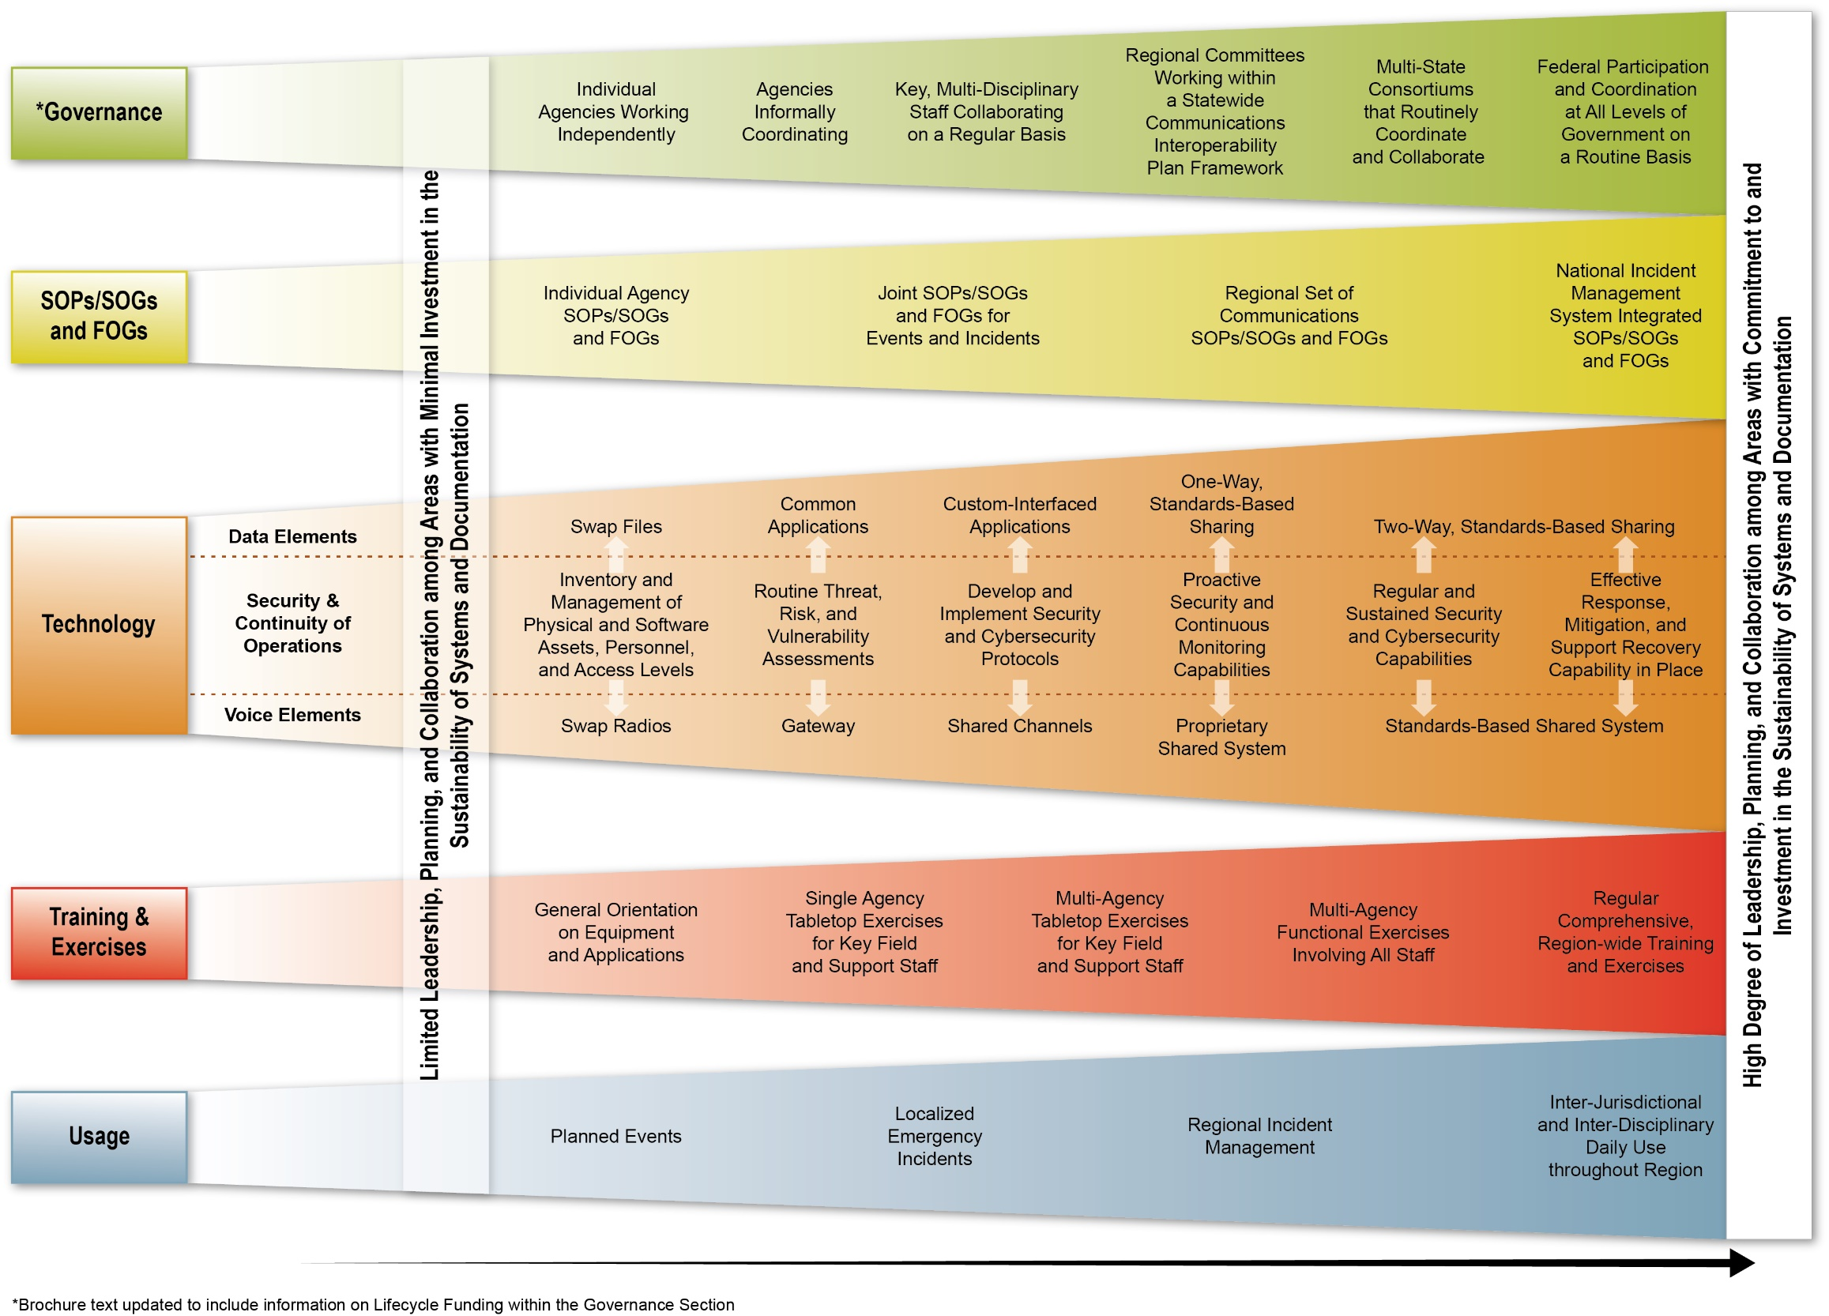
Interoperability Continuum

Slide 6
Devices and Systems in Place
Land lines
Cell phones
Contact lists
Email
MIHAN
MICIMS
EMS eBridge System
Juvare Systems
EMResource,
eICS,
EMTrack
2 Way Radios
800 MHz radios
Amateur Radios
Satellite Phones
Zoom and Teams
Website
R2N Facebook Page
Face-to-face meetings
RMCC 24/7
CHECC

Slide 7
EMResource
Web-based resource manager
Designed by clinicians for clinicians
Provides practical, convenient and holistic operational views of area and regional resources.
Provides:
Situational Awareness
Status Reporting
Bed Availability
Automated Notifications
Notes:
The statewide system used by various healthcare facility types including hospitals, long term care, and emergency medical services in Juvare EMResource. It is designed to provide clinical summary information for operational response and is viewable throughout the state. It is used to provide situational awareness, status reporting, bed and resource availability, and automatic notifications.

Slide 8
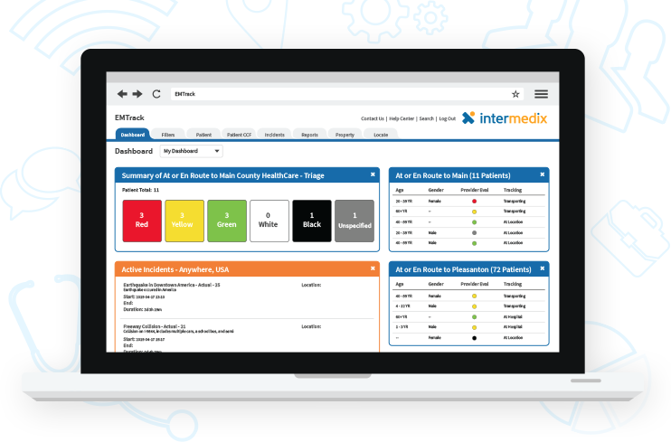
EMTrack
Web-based, multi-functional tracking system used to track patients, clients, and event participants and their property
Through disasters and planned events
Scenario Specific
Scalable Deployment
Notes:
SCENARIO-SPECIFIC CONFIGURATION
Healthcare professionals can use EMTrack to prepare for and address virtually any type of patient tracking scenario. The solution supports medical response during patient and evacuee surges caused by natural or human-caused events, such as tornados, MCIs and biohazard situations.
COMPREHENSIVE TRACKING COMPONENTS
EMTrack is comprehensive, offering web- and mobile-based components to manage incident response from beginning to end.
SCALABLE DEPLOYMENT
EMTrack is a highly scalable, interoperable, multi-agency and multi-jurisdictional tracking and communications tool.
MOBILE CAPABILITY
EMTrack’s mobile options are excellent tools for responders working at incident sites who must rely on mobile devices to gather critical client data.

Slide 9
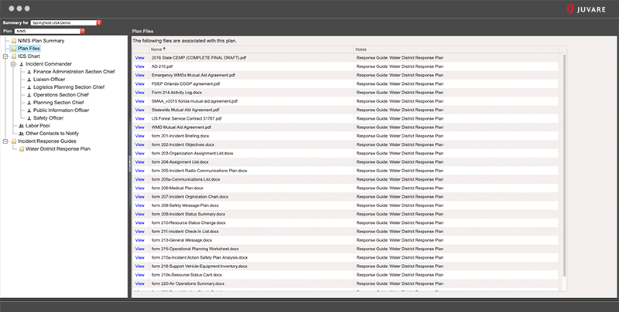
eICS
eICS
Web-based incident command
An organized way to respond to emergencies
Uses standard job roles, forms, and terminology
Used across the government, industry, and private sector, both within the U.S. and internationally
Creates a common structure for everyone to understand and operate efficiently under.
Notes:
Juvare also has an electronic incident command system call eICS. Like the related Juvare platforms, EMResource and EMTrack, it is web-based and helps organizations manage incidents. The system uses standard job roles, forms, and terminology used by the National Incident Management System (NIMS).

Slide 10
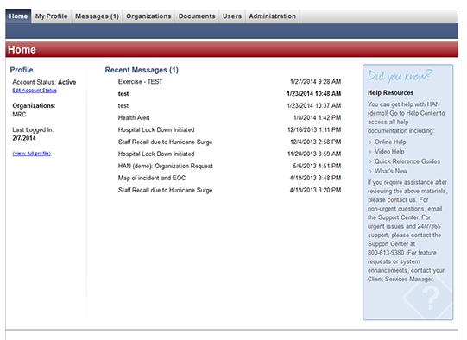
MIHAN (Michigan Health Alert Network)
Web-based notification system
Alerts medical professionals of priority news such as flu pandemics, product warnings and other immediate-need information for health care agencies and providers.
Email, text, sends voice messages to landline and cell phones, and confirms to the sender that the responder got the message.
Notes:
The Michigan Health Alert Network is a web-based notification system that also has a document library. The system is used by the State, local Public Health, and Regional Healthcare Coalitions to send out health alert notifications to those registered. Healthcare professionals register themselves and are approved. It has been used extensively during COVID, Monkeypox, and other healthcare incidents.

Slide 11
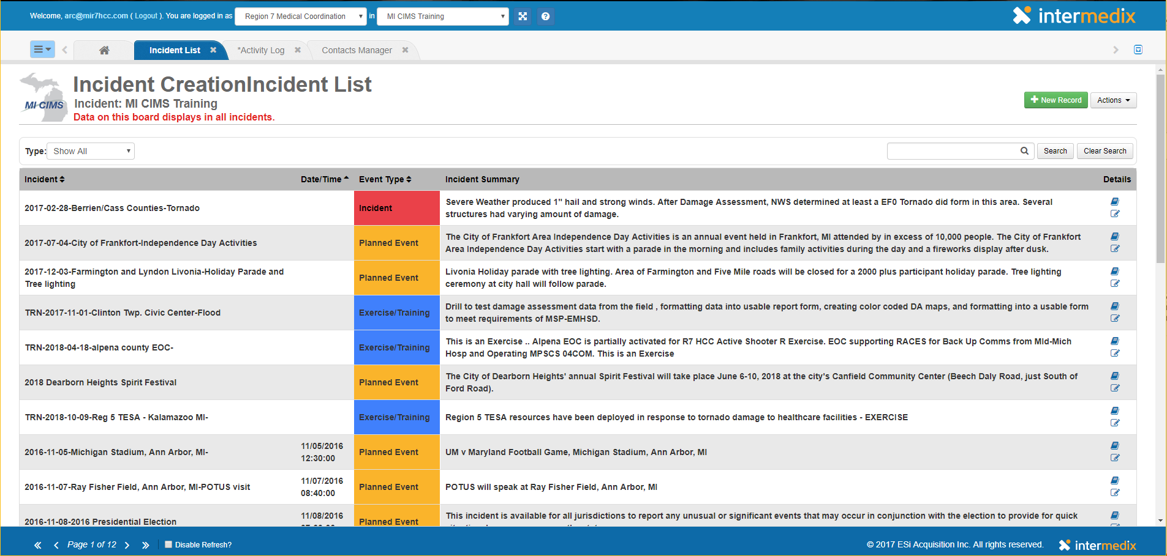
MI CIMS (Michigan Critical Incident Management System)
A web-based disaster reporting system
Dedicated method for local emergency management coordinators to report events to the State of Michigan
Details damage and needs for state assistance.
Report response, status and needs in a state-wide platform
Notes:
The Michigan Critical Incident Management System, known as MICIMS, is a WebEOC system used extensively by jurisdictional emergency management and homeland security organizations. It can be used to notify emergency management of the status of incidents by healthcare coalition regional coordinators or public health.

Slide 12
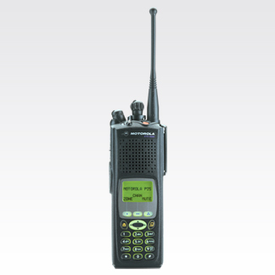
800 MHz Radios (Includes All-Disaster radios in hospitals and at other partners)
The only true interoperable radio system in the state,
Police, fire, EMS, hospitals and other agencies have their own talk-groups.
common special-event talk groups
all agencies can communicate during disaster response
Through a trunking-system and hundreds of dedicated 800 MHz towers throughout the state, a portable hand-held radio in Michigan’s Upper Peninsula can talk to another responder with a portable in Detroit, if the need exists.
Notes:
Another redundant communication system is the use of 800 Megahertz radios with specific talk groups for healthcare coalitions and the State. Most hospitals are on the system used for major disaster communications. It can be used anywhere in the State that a radio tower connection is established using the radio antenna. It is usually tested monthly for functionality by those on the system.

Slide 13
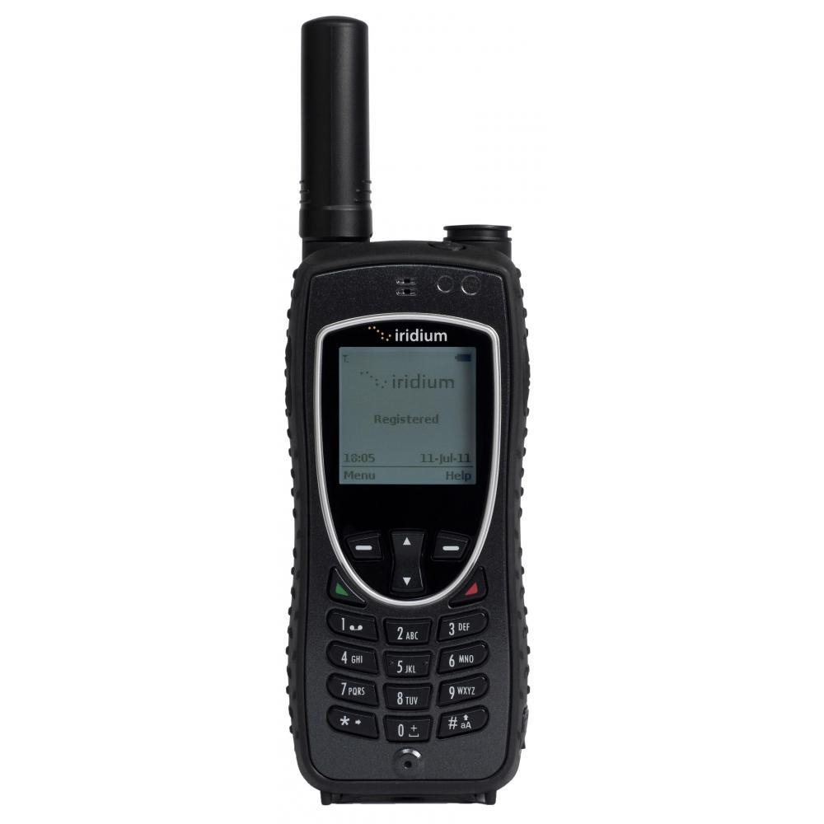
Satellite Phones
R2N staff and Bureau of Emergency Preparedness, EMS, and Systems of Care
Not dependent on cell towers or land lines
Operate solely based on orbiting satellites
Requires a clear view of the sky to operate.
Notes:
Satellite phones can also be used and are in some hospitals and with regional healthcare coalition coordinators and medical directors. These would be used in disasters with cell tower contention is so bad cell phones might not work for voice calls.

Slide 14
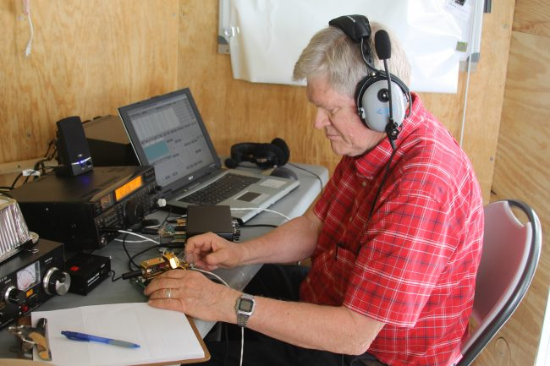
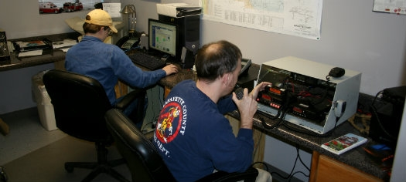
R.A.C.E.S and A.R.E.S
Volunteer Amateur Radio Enthusiasts
RACES: Radio Amateur Civil Emergency Services
ARES: Amateur Radio Emergency Services
Notes:
Volunteer Amateur Radio Enthusiasts
RACES: Radio Amateur Civil Emergency Services
members can respond in any event that the Government sees a need for additional communications needs.
The Federal Communications Commission (FCC) is responsible for the regulation of RACES operations.
Groups are administrated by a local, county, or state civil defense agency responsible for disaster services.
ARES: Amateur Radio Emergency Services
can be any event where a Communications need exists of a non-commercial nature
where all other means of communications have been exhausted.
groups assist organizations around the state in parades, non-profit organization events and local government functions/exercises
which provide training for Ham Radio Operators.

Slide 15
Other Modes of Communication
GETS: (Government Emergency Telecommunications Service) Provides priority calling privileges on land-line phones.
WPS: (Wireless Priority Service) Provides priority connection of cell phones when towers are overloaded during disasters.
TSP: (Telecommunications Service Priority) Provides priority service in new line installation or repair of existing lines.
460 MHz Radios: Short range, hand-held radios available to the public, commonly used for hiking, hunting, etc
Notes:
There are federal processes to give priority to healthcare and emergency responders including: Read first three items from chart.
There are also short-range radios used around facilities for direct radio to radio communications. These are often referred to as family service radios. Most of the ones used by healthcare facilities are higher end units with longer and stronger connections.

Slide 16
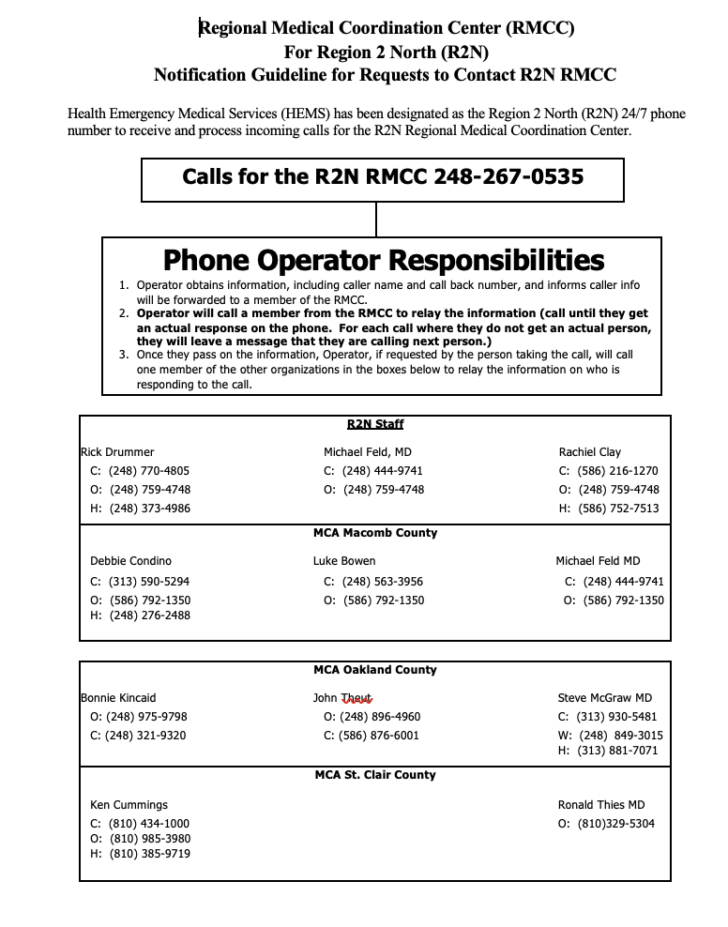
Communicating with your Regional Medical Coordination Center (RMCC)
Emergencies and RMCC Activation
What constitutes an emergency?
When to seek regional assistance?
How to activate the R2N RMCC: 248-267-0535
Situational awareness vs. Action needed (call for both)
Notes:
Each of the Michigan Healthcare Coalitions has a Regional Medical Coordination Center that can be activated for events or emergencies to provide situational awareness and communications and collaboration with hospitals, local jurisdictional authorities, EMS, other regions, and the State Medical Branch of the State EOC called the Community Health Emergency Coordination Center (CHECC). Where Healthcare Coalitions operate daily for planning, training, exercises, and communications, the RMCC has specific 24/7 response roles.

Slide 17
Final Thoughts
Monthly communications exercises used to test functionality and knowledge of:
EMResource Update
800 MHz radios
MIHAN response
Doing functional exercises beneficial so people know how to use the methods in a real incident
Communications usually the biggest breakdown/improvement need from real after-action reports

