Slide 1
INCIDENT COMMAND SYSTEM (ICS) An Overview for Healthcare Organizations (this is not an ICS FEMA course)
Presented as part of the Michigan Healthcare Coalition Regional Coordinators monthly Back to the Basics overviews
January 17, 2023
Rick Drummer, R2N HCC Regional Coordinator

Slide 2
Overview Objectives
Describe how ICS became the standard for emergency management across the country.
Provide examples of how ICS is interdisciplinary and organizationally flexible.
Identify five major management functions.
Determine how you can increase the use of ICS at your healthcare facility

Slide 3
Imagine planning a large family reunion at a park
Option A – Leave it to chance and hope for the best

Slide 4
Imagine planning a large family reunion at a park
Option B – Work with family members, assign tasks, track results
You are budgeting, calculating costs, and collecting money
Uncle Ben is lead organizer
Mom is putting together contact list
Sister Gail is doing entertainment and games
Dad is managing the grill
Sister Mary Jo is making sure out-of-towners have a place to stay
Brother Tom is getting shelter
Brother Bruce is checking weather and making sure site is safe and who has food allergies
Sister Cindy is creating flyer and contacting relatives
Aunt Jane is planning food menu
Aunt Sally is working with park office
Aunt Jane is ordering food
Uncle Bob is getting coolers for drinks and food

Slide 5
Imagine planning a large family reunion at a park
Incident Command
Uncle Ben is lead organizer
Safety
Liaison
Brother Bruce is checking weather and making sure site is safe and who has food allergies
Aunt Sally is working with park office
Operations
Planning
Logistics
Finance/Administration
Dad is managing the grill
Mom is putting together contact list
Sister Mary Jo is making sure out of towners have a place to stay
You are budgeting, calculating costs, and collecting money
Sister Cindy is creating flyer and contacting relatives
Aunt Jane is planning food menu
Brother Tom is getting shelter
Sister Gail is doing entertainment
Uncle Bob is getting coolers for drinks and food
Aunt Jane is ordering food

Slide 6
Imagine planning a large family reunion at a park
Incident Command
(Leader)
Safety
Uncle Ben is lead organizer
Liaison
Brother Bruce is checking weather and making sure site is safe and who has food allergies
Aunt Sally is working with park office
Operations
(Doers)
Planning
(Thinkers)
Logistics
(Getters)
Finance/Administration
(Payers/Recorders)
Dad is managing the grill
Mom is putting together contact list
Sister Mary Jo is making sure out of towners have a place to stay
You are budgeting, calculating costs, and collecting money
Sister Cindy is creating flyer and contacting relatives
Aunt Jane is planning food menu
Brother Tom is getting shelter
Sister Gail is doing entertainment
Uncle Bob is getting coolers for drinks and food
Aunt Jane is ordering food

Slide 7
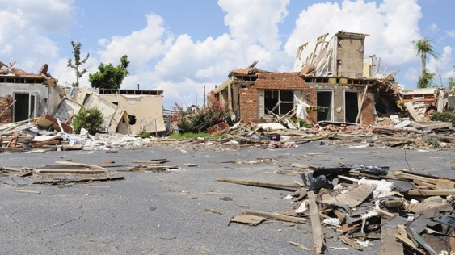
Types of Events for Incidents
CNN: At least two hospitals in Northern California evacuated patients as deadly wildfires spread across at least 57,000 acres, destroying 1,500 structures, officials said Monday.
Events
Exercises
Large group celebrations
Major structural changes
Incidents:
Fire, both structural and wildfire
Hazardous materials incidents
Natural disasters
Terrorist/WMD events
Cyber Attacks

Slide 8
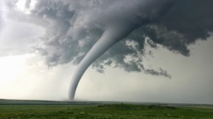
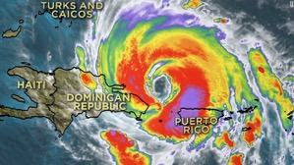
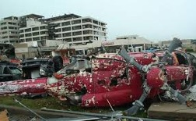
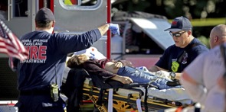
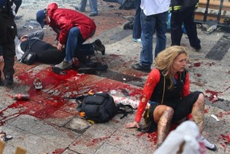
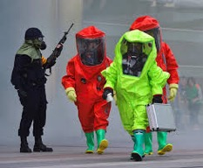
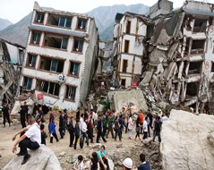
Categories of Disasters
Relatively small-scale mass injury/illness events
Large-scale natural disaster
Complex mass casualty events
Catastrophic health events
Source: “A Framework for Healthcare Disaster Resilience: A View to the Future” Johns Hopkins

Slide 9
Best possible way to deal with events/incidents
“In the experience of this author, the components that contribute to an incident being mitigated in the most efficient and effective manner…are command, control, coordination, communication and collaboration. If your incident management system accounts for each of these components, you will have given your staff, patients, and supporting agencies the best possible opportunity to deal with the majority of events your facility may face.”
Hospital Emergency Response Teams - by Jan Glarum, Don Birou, Edward Cetaruk, MD, 2010, Elsevier Inc.

Slide 10
Creation of ICS
The fire service identified the obvious need for a new approach to the management of rapidly moving wildfires in the early 1970s.
Too many people reporting to one supervisor
Different emergency response organizational structures had difficulty working together
Poor communications
Unclear who was in-charge and who you reported to
Terminology was different between organizations
Unclear or unspecified incident objectives
Standardized system created and modified over time, expanded to other organizations, and became the national standard

Slide 11
ICS is part of NIMS National Incident Management System Principles
Common Terminology
Modular Organization
Management by Objectives
Incident Action Planning
Manageable Span of Control
Incident Facilities and Locations
Comprehensive Resource Management
Integrated Communications
Establishment and Transfer of Command
Unified Command
Chain of Command and Unity of Command
Accountability
Dispatch/Deployment
Information and Intelligence Management

Slide 12
What Is ICS?
Standardized, on-scene, all-hazard incident management concept.
Allows its users to adopt an integrated organizational structure.
Has considerable internal flexibility.
A proven management system based on successful business practices (command, control, coordination, communication and collaboration).
The result of decades of lessons learned in the organization and management of emergency incidents.

Slide 13
Weaknesses Addressed by ICS
Lack of accountability, including unclear chain of command and supervision.
Poor communication, including system and terminology problems.
Lack of an orderly, systematic planning process.
No common, flexible, predesigned management structure.
No predefined methods to integrate interagency requirements into the management structure and planning process.

Slide 14
What ICS Is Designed To Do
Meet the needs of incidents of any kind or size.
Allow personnel from a variety of agencies to meld rapidly into a common management structure.
Provide logistical and administrative support to operational staff.
Be cost effective by avoiding duplication of efforts.
ICS has been tested in more than 30 years of emergency and non-emergency applications, by all levels of government and in the private sector.

Slide 15
Five Major Management Functions
Incident Command
Operations Section
Planning Section
Logistics Section
Finance/ Administration Section

Slide 16
Five Major Management Functions
Incident Commander is the only position required, the others are scalable
Incident Command
Operations Section
Planning Section
Logistics Section
Finance/ Administration Section

Slide 17
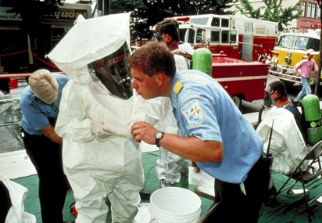
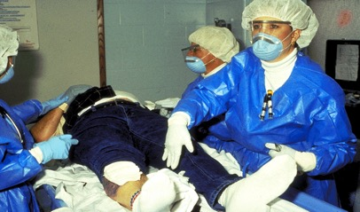
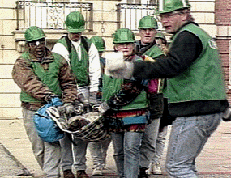
ICS Position Titles
Provide a common standard for all users.
Distinct titles allow for filling positions with the most qualified individuals.
Useful when requesting personnel.

Slide 18
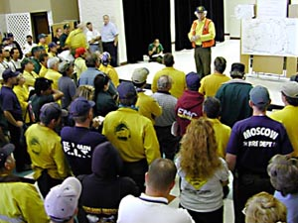
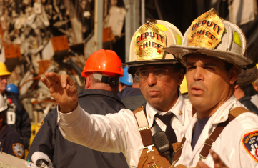
Formal ICS Organizational Components
Most Healthcare Organizations will not use many of these components by title, but supporting responders will (Fire/EMS/Emergency Management
Section
Division
Group
Branch
Task Force
Strike Team
Single Resource

Slide 19
Incident Commander’s Role
Has overall responsibility for managing the event or incident.
Must be fully briefed and should have a written delegation of authority.
Personnel assigned by the Incident Commander have the delegated authority of their assigned positions.
Only position that is always filled.

Slide 20
Incident Commander Responsibilities
Overall command and control.
Ensures incident responder safety.
Protects health and safety of the general public and the environment.
Provides information to internal and external stakeholders.
Maintains liaison with other agencies.
For most incidents – suggest having a scribe keep track of communications, decisions, objectives, help maintain a common operation picture, and more...

Slide 21
Expanding Command Staff
Incident Command
Public Information Officer
Command Staff:
The Command Staff provide Information, Safety, and Liaison services for the entire organization.
Safety Officer
Liaison Officer
General Staff:
The General Staff are assigned functional authority for Operations, Planning, Logistics, and Finance/Administration.
Operations Section
Planning Section
Logistics Section
Finance/ Administration Section
Section Chiefs

Slide 22
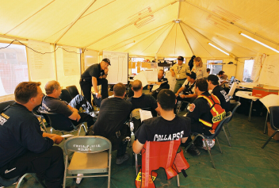
Command Staff
Public Information Officer
Safety Officer
Liaison Officer

Slide 23
PIO Responsibilities
Advise the Incident Commander on information dissemination and media relations.
Serve as the primary contact for anyone who wants information.
Serve external audience and internal audience.
Obtain information from the Planning Section.
Coordinate with other public information staff.
Obtain information from the community, the media, and others.

Slide 24
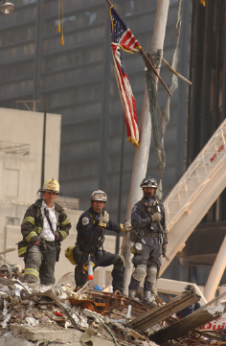
Safety Officer Responsibilities
Ensures responder safety.
Advises Incident Command on safety issues.
Minimizes employee risk.

Slide 25
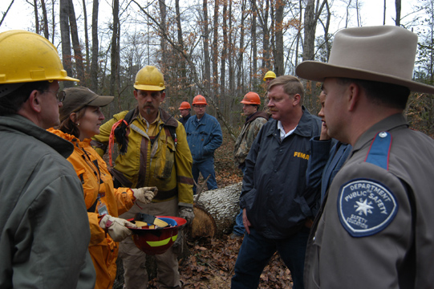
Liaison Officer Responsibilities
Gathers information about support agencies.
Coordinates for agencies not in command structure.
Provides briefings and answers questions.

Slide 26
Understanding the General Staff
Has overall responsibility for the incident. Sets objectives.
Incident Command
Operations Section
Planning Section
Logistics Section
Finance/ Administration Section
Develops tactical organization and directs all resources to carry out the Event/Incident Action Plan
Develops Incident Action Plan to accomplish the objectives (includes events)
Provides resources and services needed to support the event/incident
Monitors event/incident-related costs. Provides overall fiscal guidance.

Slide 27
Operations Section Chief Role
Develop and manage the Operations Section.
Develops and implements strategies and tactics.
Work very closely with other members of the Command and General Staff to coordinate tactical activities.

Slide 28
Planning Section Chief Roles
Gathers and analyzes information.
Gathers, analyzes, and disseminate intelligence and information.
Manages the planning process.
Compiles and develops the Incident Action Plan.
Manages the activities of Technical Specialists.
Works closely with the Incident Commander and General Staff.

Slide 29
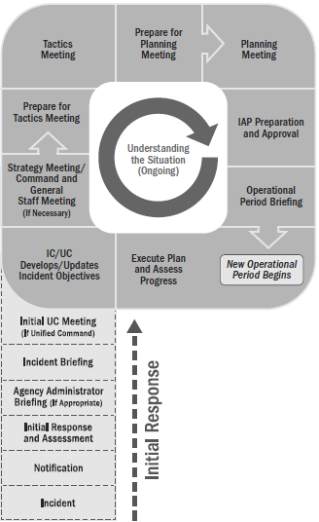
Operational Period Planning Cycle The Planning P

Slide 30
Incident Action Plan Elements
What, Where, When, Who, How?
What do we want to do?
Where do we stage?
When are we going to do it?
Who is responsible for doing it?
How do we communicate with each other?
What is the procedure if someone is injured?

Slide 31
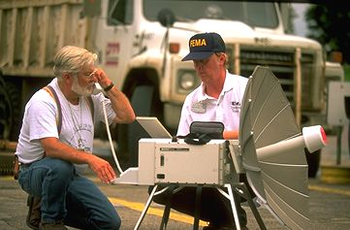
Logistics Section Chief: Role
Provides resources and services to support the incident.
Develops portions of the IAP.
Contracts for goods and services.

Slide 32
Finance/Administration Section Chief: Role
Negotiate contracts.
Time keeping for personnel and equipment.
Documenting and processing claims.
Tracking costs.

Slide 33
Sample SNF ICS Chart

Slide 34
Communications within ICS
The ability to communicate with ICS is critical.
Use standard, common terminology.
Avoid jargon.
Use standard ICS position titles and facility names.
Develop a communications plan and protocols specific to the incident.
Determine flow path for communications.
Use Essential Elements of Information (EEI) to communicate what is important to support timely and informed decisions.

Slide 35
Communications Discipline
Observe strict radio/telephone procedures.
Use plain English in all communications.
Limit radio and telephone traffic to essential information only.
Follow procedures for secure communications as required.

Slide 36
Incident Recordkeeping
Print or type all entries.
Enter dates by month/day/year format.
Enter date and time on all forms and records. Use local time.
Fill in all blanks. Use N/A as appropriate.
Use military 24-hour time.
Section Chiefs and above should assign a log keeper (scribe).

Slide 37
Incident Demobilization
Complete work assignments.
Brief replacements, subordinates, and supervisor.
Follow check-out procedures.
Provide follow-up contact information.
Return incident-issued equipment.
Complete post-incident reports, critiques, evaluations, and medical follow-up.
Resolve payment and/or payroll issues.

Slide 38
Observations from reading After Action Reports and Observing Exercises
Practice using the terminology and structure, including for small events
Write down the objectives for the next period of time
Keep operational periods reasonable (several hours or days)
Put it ”on the wall” so others can see it (fill out a chart)
Don’t rely on technology to always work (don’t underestimate the value of dry wipe boards, chart pads, T-cards)
Have those who might be in the Incident Command positions trained (include weekend staff, house supervisors, etc.)
If possible, use ICS forms to help with documentation and recovery
Consider using the eICS system if you do not already have one in place at a hospital

Slide 39
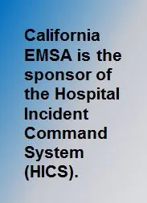
HICS
The Hospital Incident Command System (HICS) Purpose
HICS is an incident management system based on principles of the Incident Command System (ICS), which assists hospitals and healthcare organizations in improving their emergency management planning, response, and recovery capabilities for unplanned and planned events. HICS is consistent with ICS and the National Incident Management System (NIMS) principles.
The principal beneficiaries of HICS will continue to be anyone with a response role during a crisis including hospital physicians, nurses, and administrators. Community partners with whom hospitals collaborate (e.g., public safety, local health department, emergency management, etc.) as well as students of emergency management will find the information on this website useful in understanding healthcare response issues and incident command practices and tools used during various events with health impacts.

Slide 40
Best way to know if you have a good grasp of ICS is to exercise it

Slide 41
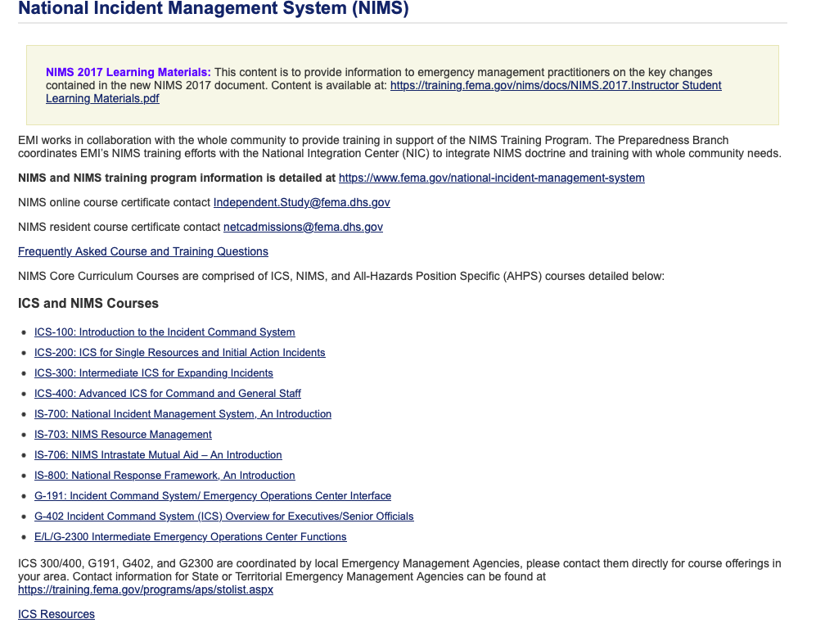
Want to learn more? https://training.fema.gov/nims/

Slide 42
Thank you for listening

