Slide 1
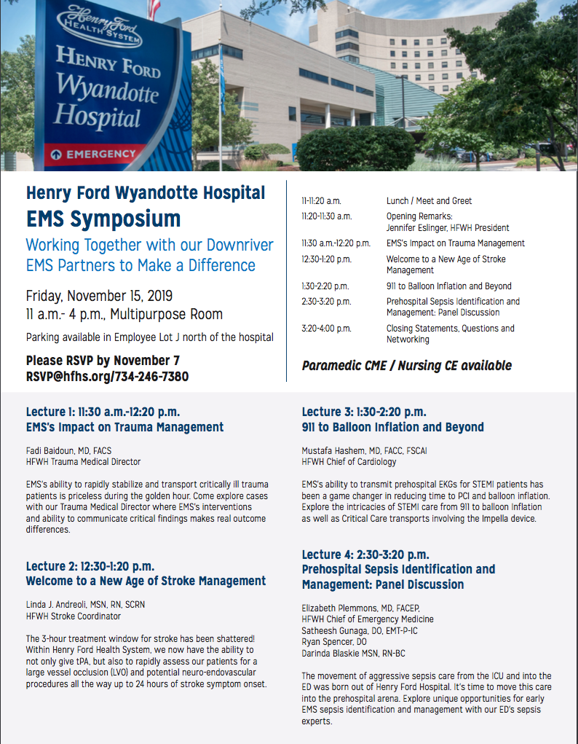
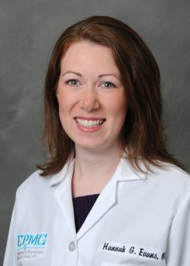
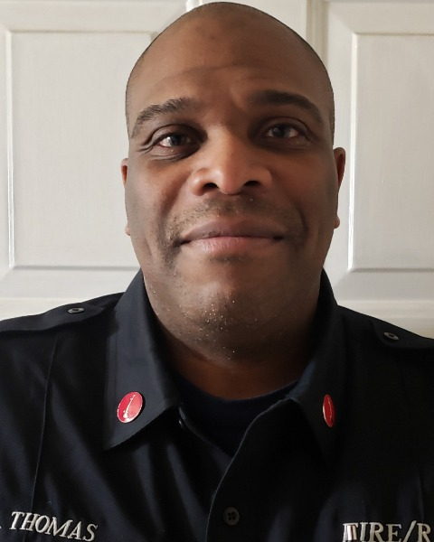

Henry Ford Wyandotte Hospital
From Field to Floor: Multidisciplinary Care CME Series
CME Approved for EMT-B and EMT-P
CME Available for Physicians & Acceptable for Nursing Prelicensure
Lecture and Round Table Discussion: 1PM – 3PM
Train Derailment and Toxic Chemical Release:
Fundamental of Hazardous Incident Management
Hannah Evans¹, MD, FACEP and Lieutenant Eric Thomas², EMT-P, Fire Instructor, HazMat Instructor
¹HEMS EMS Medical Director / DERT Team Physician Advisor / HFWH Division Head of EMS
²Hazmat Team Training Coordinator Western Wayne and Downriver Emergency Response Team
In February, our hearts went out to the community of East Palestine, Ohio, as they grappled with the chaos and potential danger caused by a train derailment that released hazardous materials into their environment. It was a stark reminder of the potential risks posed by railways near our own homes, schools, businesses, and parks. Many of us couldn't help but wonder, "What if that happened here?"
Join us for an engaging and informative lecture followed by an expert-led discussion. We will delve into every aspect of this critical issue, from the initial response to mitigation strategies and everything in between. Don't miss this opportunity to gain valuable insights and knowledge that can help us better prepare for and respond to such emergencies in our own communities.
Tuesday, September 26th, 2023
1 pm – 3 pm : In person and Zoom
Please Join In Person
Henry Ford Wyandotte Hospital Baidoun Conference Room
Fourth Floor Honor Building
Please Join Virtually on Zoom
Join Zoom Meeting https://us02web.zoom.us/j/88096375415?pwd=b3NEcGl3c0R4Z2phc0FlS29QODg2Zz09
Meeting ID: 880 9637 5415
Passcode: FordCME
EMS PLEASE REGISTER AT: https://www.mi-emsis.org/lms/public/portal#/login
Search for class number: 21-ICE-08039
Contact TJ Manning for any questions: tmannin3@hfhs.org
Continuing Medical Education (ACCME) to provide continuing medical education for physicians. DESIGNATION STATEMENT: Henry Ford Health System designates this educational activity for a maximum of 2.00 AMA PRA Cate[1] gory 1 Credit(s)™. Physicians should only claim credit commensurate with the extent of their participation in the activity. FACULTY/PLANNING COMMITTEE DISCLOSURE STATEMENT: In Compliance with the ACCME Standards for Commercial Support, all individuals in a position to control/influence the content of this activity are required to disclose relevant financial interests of their own or spouse or partners with any ACCME defined commercial interests for the past 24 months and/or any non-FDA approved use of a drug or a device that is included in the presentation. All relevant financial relationships have been mitigated. ACCESSIBILITY STATEMENT: Henry Ford Health System Office of Continuing Medical Education is committed to ensuring that its programs, services, goods and facilities are accessible to individuals with disabilities as specified under Section 504 of the Rehabilitation Act of 1973 and the Americans with Disabilities Amendments Act of 2008. If you have needs that require special accommodations, including dietary concerns, please contact the CME Conference Coordinator

