Slide 1
Emergency Preparedness & The Cities Readiness Initiative (CRI) Overview

Slide 2
Local Public Health Emergency Preparedness Grants
PHEP
CRI
The Public Health Emergency Preparedness (PHEP) cooperative agreement
This helps health departments build and strengthen their abilities to effectively respond to a range of public health threats, including infectious diseases, natural disasters, and chemical, biological, radiological, and nuclear (CBRN) events.
CDC’s Cities Readiness Initiative (CRI)
CRI is a federally funded program that enhances preparedness in the nation’s largest population centers, where nearly 60% of the population resides. The program prepares jurisdictions to effectively respond to large public health emergencies with life-saving medicines and medical supplies.

Slide 3
CRI Participating Cities and Metropolitan Areas The CRI project began in 2004 with 21 cities. It has since expanded to a total of 72 metropolitan statistical areas (MSAs) with at least one CRI city in every state.
CDC provides CRI funds to 50 states and four large metropolitan areas.

Slide 4
CRI Locations Cont.
Albany, NY Albuquerque, NM Anchorage, AK Atlanta, GA Baltimore, MD Baton Rouge, LA Billings, MT Birmingham, AL Boise, ID Hartford, CT Honolulu, HI Houston, TX Indianapolis, IN Jackson, MS Kansas City, MO Las Vegas, NV Little Rock, AR Los Angeles, CA Louisville, KY Manchester, NH Memphis, TN Miami, FL Milwaukee, WI Minneapolis, MN
Boston, MA Buffalo, NY Burlington, VT Charleston, WV Charlotte, NC Cheyenne, WY Chicago, IL Cincinnati, OH Cleveland, OH Nashville, TN New Haven, CT New Orleans, LA New York City, NY Oklahoma City, OK Omaha, NE Orlando, FL Peoria, IL Philadelphia, PA Phoenix, AZ Pittsburgh, PA Portland, ME Portland, OR Providence, RI Richmond, VA
Columbia, SC Columbus, OH Dallas, TX Denver, CO Des Moines, IA Detroit, MI Dover, DE Fargo, ND Fresno, CA Riverside, CA Sacramento, CA Salt Lake City, UT San Antonio, TX San Diego, CA San Francisco, CA San Jose, CA Seattle, WA Sioux Falls, SD St. Louis, MO Tampa, FL Trenton, NJ Virginia Beach, VA Washington, DC Wichita, KS

Slide 5
Grant Requirements
PHEP
CRI

Slide 6
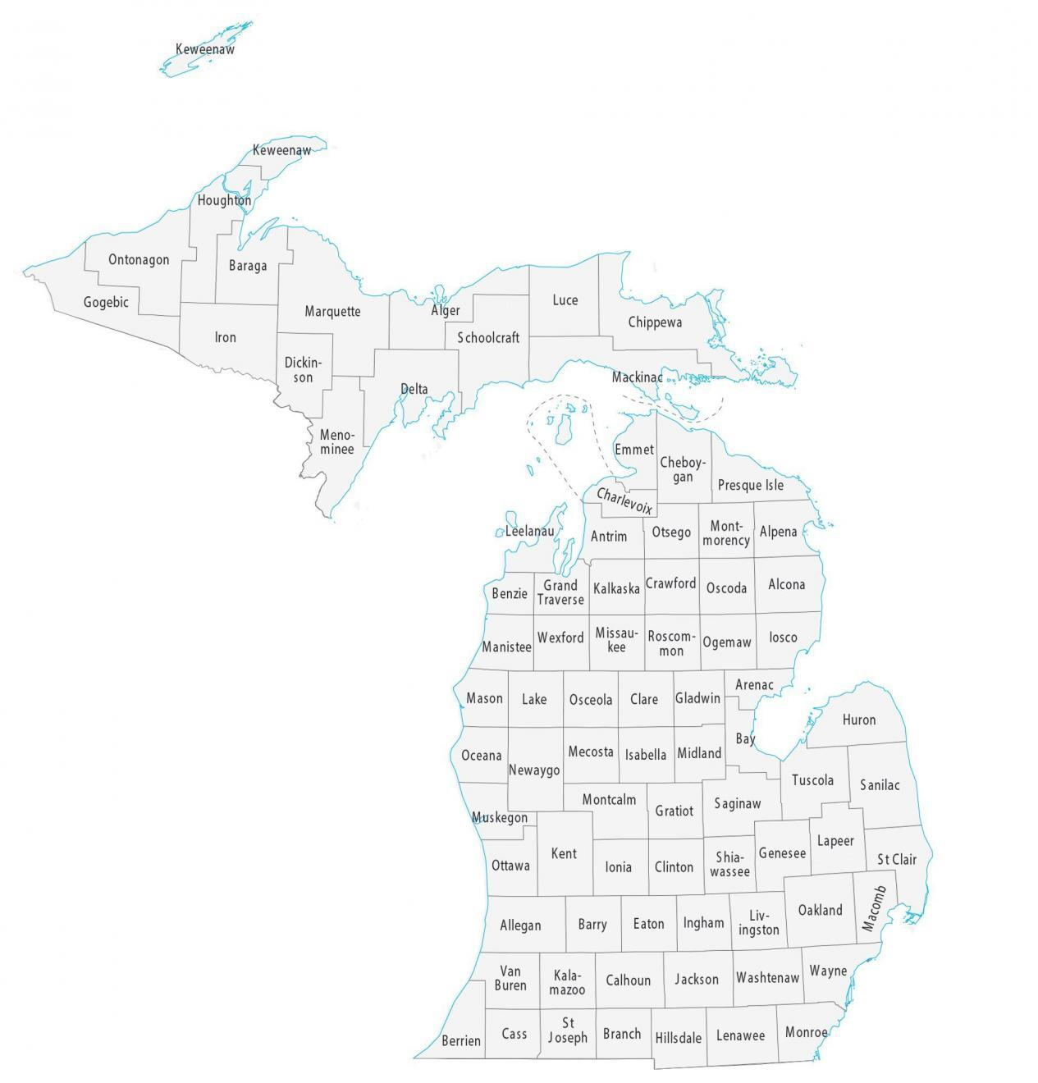
CRI Jurisdictions
City of Detroit
Lapeer
Livingston
Macomb
Oakland
St. Clair
Wayne
MDHHS - BEPESoC
Additional Jurisdictions
Monroe
Washtenaw
HCCs
R2N
R2S

Slide 7
Planning
ESF 8
 | Public Health Preparedness Capabilities | Healthcare Preparedness Capabilities
1 | Community Preparedness | Healthcare & Medical Readiness
2 | Community Recovery | Continuity of Healthcare Service Delivery
3 | Emergency Operations Coordination | Healthcare & Medical Response Coordination
4 | Emergency Public Information and Warning
5 | Fatality Management
6 | Information Sharing
7 | Mass Care
8 | Medical Countermeasure Dispensing
9 | Medical Materiel Management and Distribution
10 | Medical Surge | Medical Surge
11 | Non-pharmaceutical Interventions
12 | Public Health Laboratory Testing
13 | Public Health Surveillance and Epidemiological Investigation
14 | Responder Safety and Health
15 | Volunteer Management
Table 1: Public Health and Healthcare Preparedness Capabilities

Slide 8
Current Planning
Collaborative Project for CRI/SNS Group
CBRNE Grid project review.
Currently on hold
Cobalt Magnet 25 – Exercise between MSP/EM/FEMA for a nuclear/radiological incident.
May play into part of our future planning goals.
Review CDC Radiological Emergencies Sheltering docs/info.
Training Videos

Slide 9
Thank you!
Any Questions?

